Slide 1
Annual flu programme resources for healthcare professionals and the public
UKHSA September 2023

Slide 2
| Resources to support the flu programme
Healthcare professional (HCP) facing

Slide 3
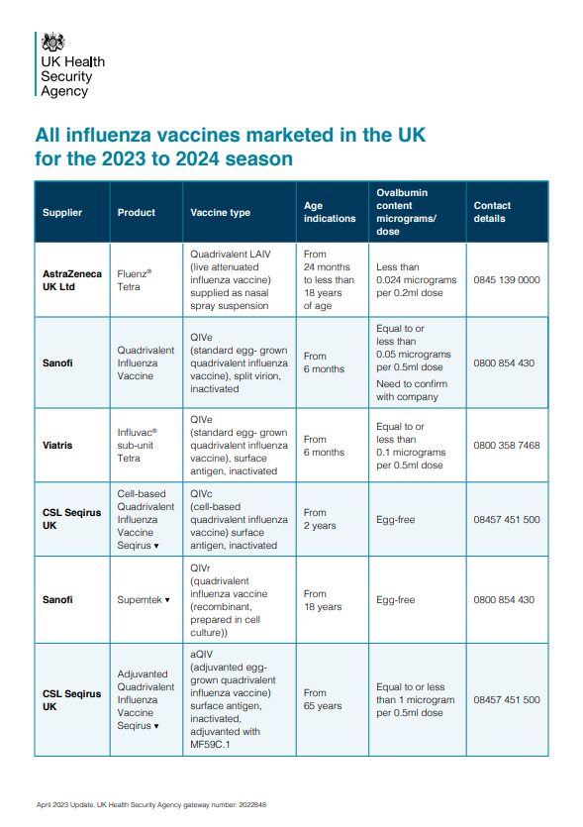
All influenza vaccines marketed in the UK for the 2023 to 2024 season
https://assets.publishing.service.gov.uk/government/uploads/system/uploads/attachment_data/file/1145001/UKHSA_Influenza_ovalbumin-table-_2023-2024.pdf

Slide 4
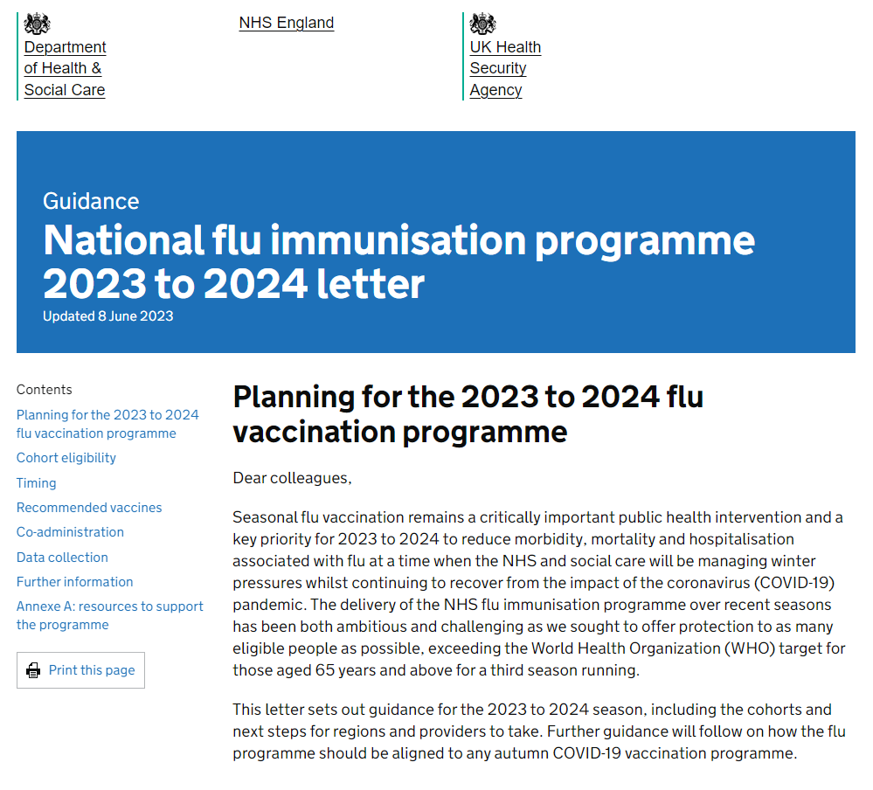
Tripartite annual flu letter 2023 to 2024
www.gov.uk/government/publications/national-flu-immunisation-programme-plan
Publication timeline:
25 May 2023 – 2023/24 letter published.
8 June 2023 – updated to include a footnote (no 1). This clarifies that eligibility for flu vaccine is not limited to “those living in long-stay residential care homes”, it “includes other long-stay care facilities where rapid spread is likely to follow introduction of infection and cause high morbidity and mortality (this does not include prisons, young offender institutions, university halls of residence etc.)” as set out in the Green Book.
3 July 2023 – updated to reflect the inclusion of secondary school aged children from Years 7 to 11 within the programme.

Slide 5
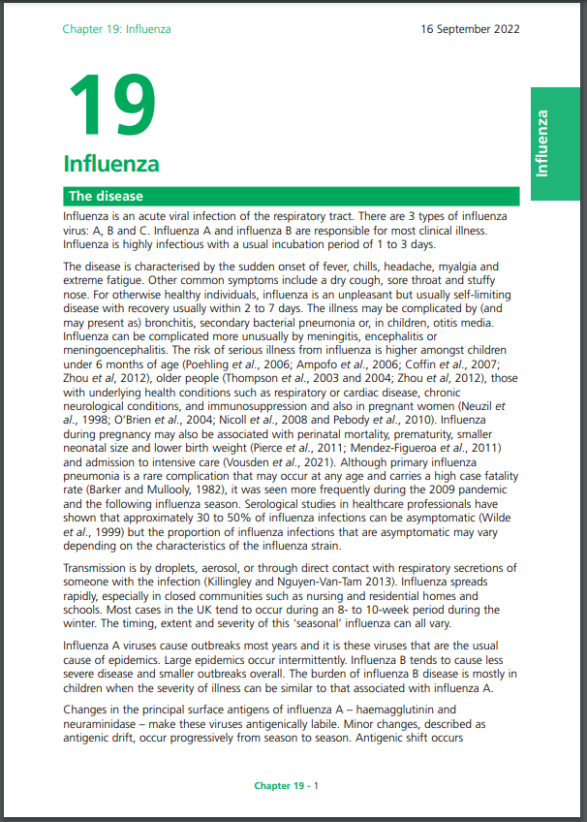
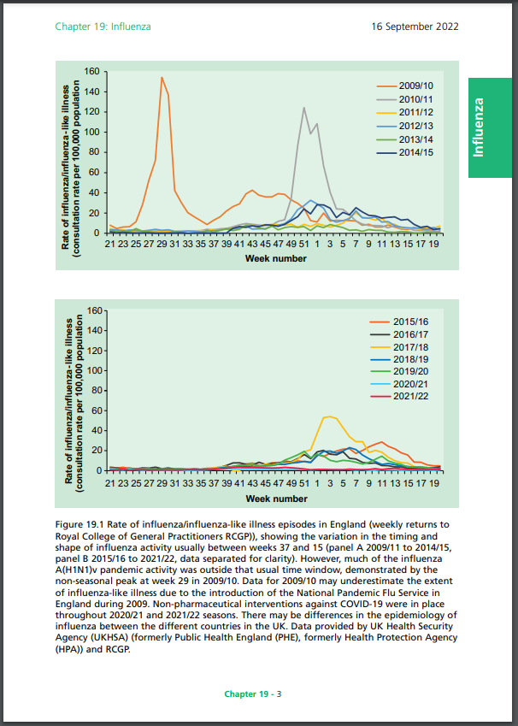
| Green Book - Influenza: chapter 19
www.gov.uk/government/publications/influenza-the-green-book-chapter-19

Slide 6
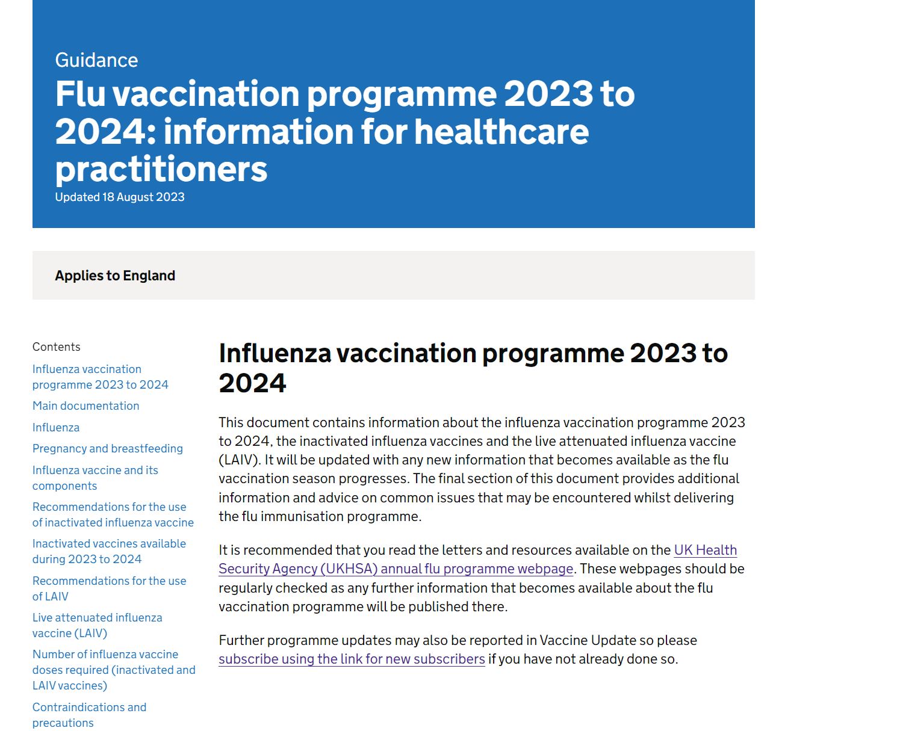
| Flu vaccination programme 2023 to 2024: information for healthcare practitioners
Also see:
www.gov.uk/government/publications/flu-immunisation-training-recommendations

Slide 7
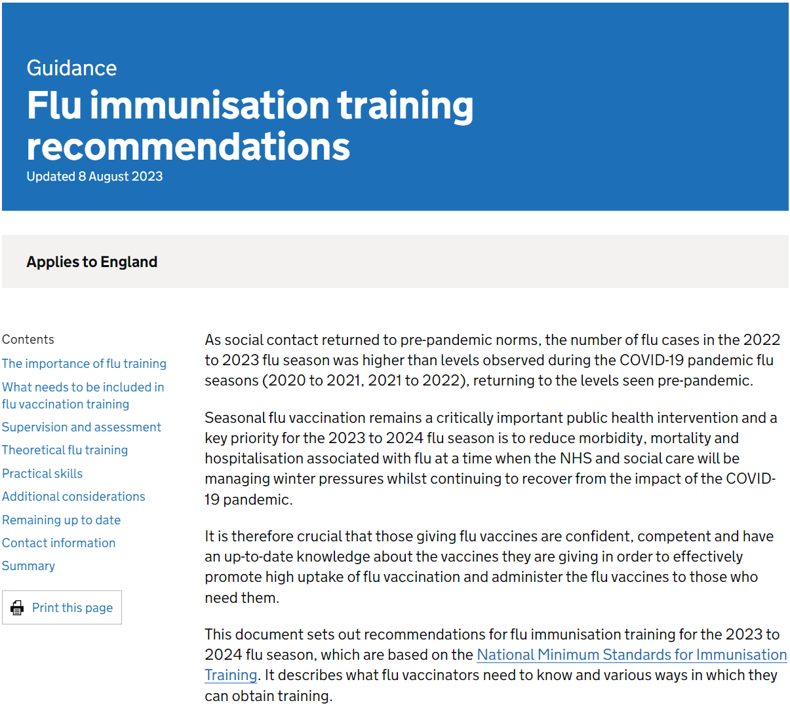
| Flu vaccination programme 2023 to 2024: training recommendations and training slide set
Training slide set link
www.gov.uk/government/publications/flu-immunisation-training-recommendations/flu-immunisation-training-recommendations

Slide 8
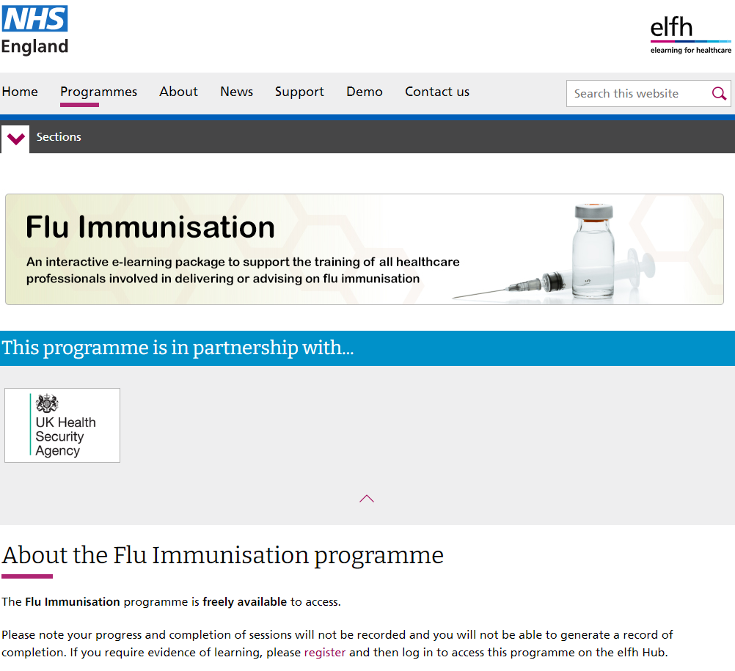
| Flu vaccination programme 2023 to 2024: e-learning programme
www.e-lfh.org.uk/programmes/flu-immunisation/

Slide 9
Flu surveillance and vaccine uptake
Flu surveillance reports: www.gov.uk/government/statistics/national-flu-and-covid-19-surveillance-reports-2023-to-2024-season
Flu vaccine uptake data: www.gov.uk/government/collections/vaccine-uptake#seasonal-flu-vaccine-uptake:-figures

Slide 10
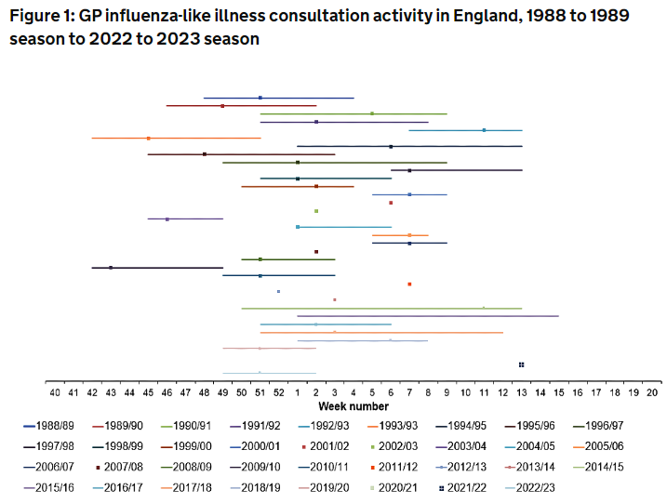
Timing of flu seasons
www.gov.uk/government/publications/respiratory-virus-circulation-england-and-wales/timing-of-influenza-seasons

Slide 11
Ordering copies of resources
Paper copies of many flu resources are available to order at:
www.healthpublications.gov.uk
Resources in the following slides, which are available to order, are marked with this product code stamp:
Other resources are download only:
Search for this asset code on the Health Publications website to order copies
Product code: xxxxxxxxx
Product code: xxxxxxxxx
Download only

Slide 12
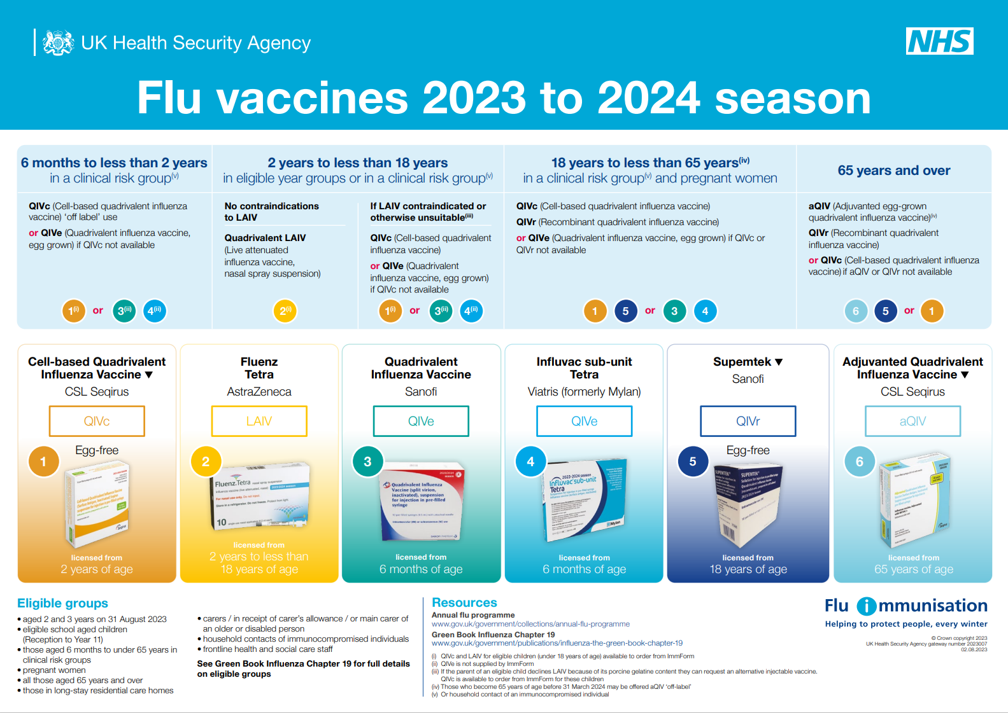
| Vaccine Landscape
Product code: 2023007
Download only
www.gov.uk/government/publications/flu-vaccines-for-the-current-season

Slide 13
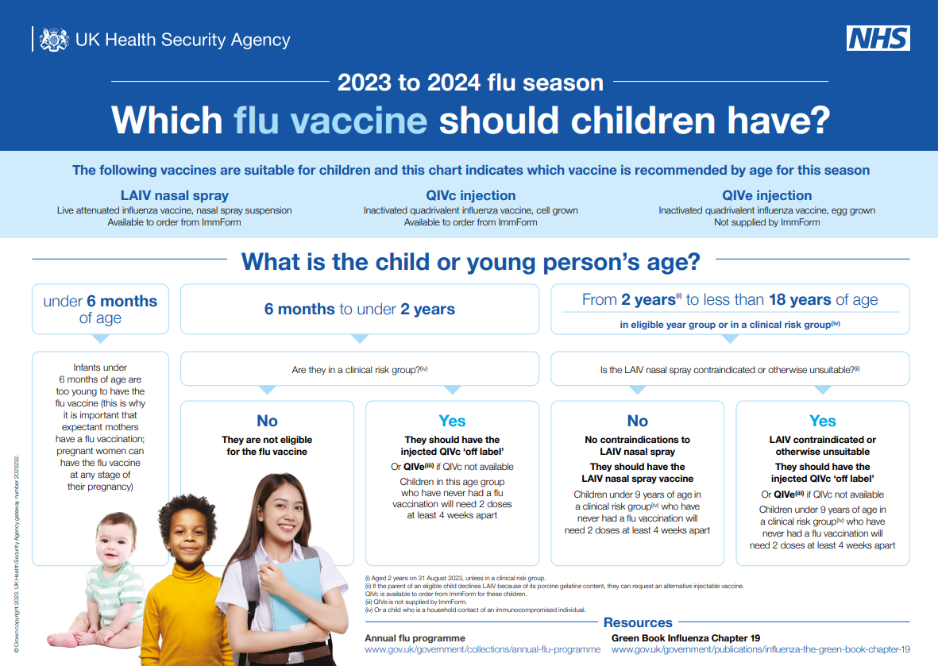
| Resources to support the children’s flu programme - HCP
Product code: 2023232
Download only
www.gov.uk/government/publications/which-flu-vaccine-should-children-have

Slide 14
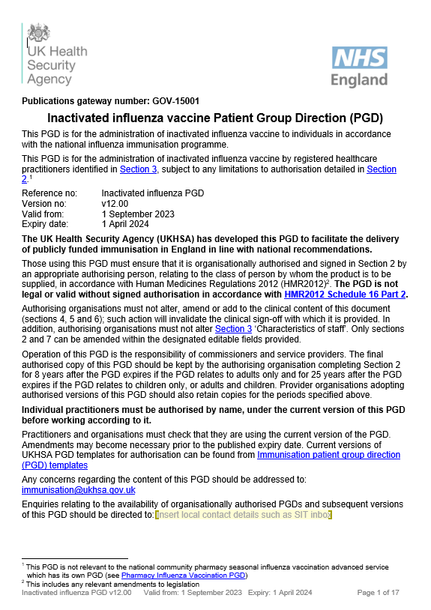
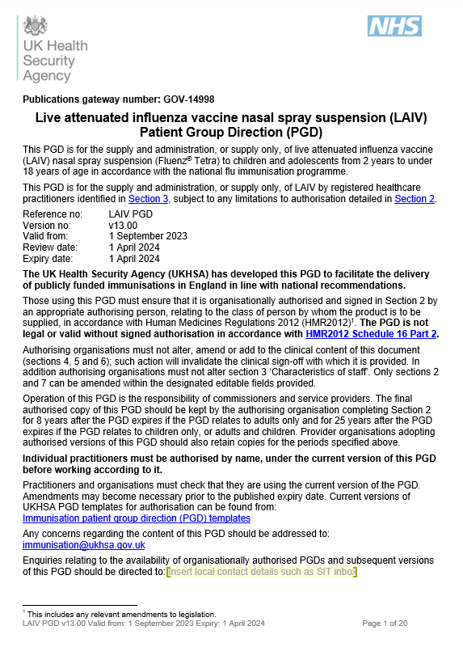
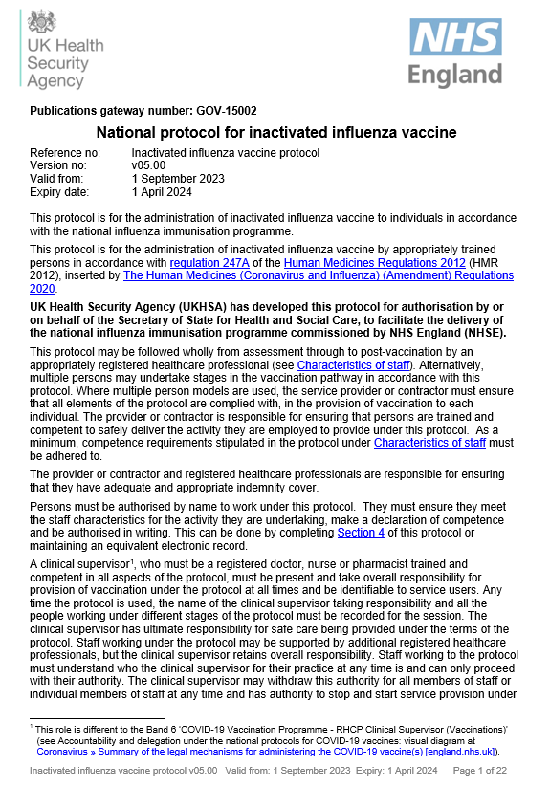
| Patient Group Directions (PGDs) and national protocol
IIV PGD
LAIV PGD
National Protocol
www.gov.uk/government/publications/intramuscular-inactivated-influenza-vaccine-patient-group-direction-pgd-template
www.gov.uk/government/publications/influenza-vaccine-fluenz-tetra-patient-group-direction-pgd-template
www.gov.uk/government/publications/national-protocol-for-inactivated-influenza-vaccine

Slide 15
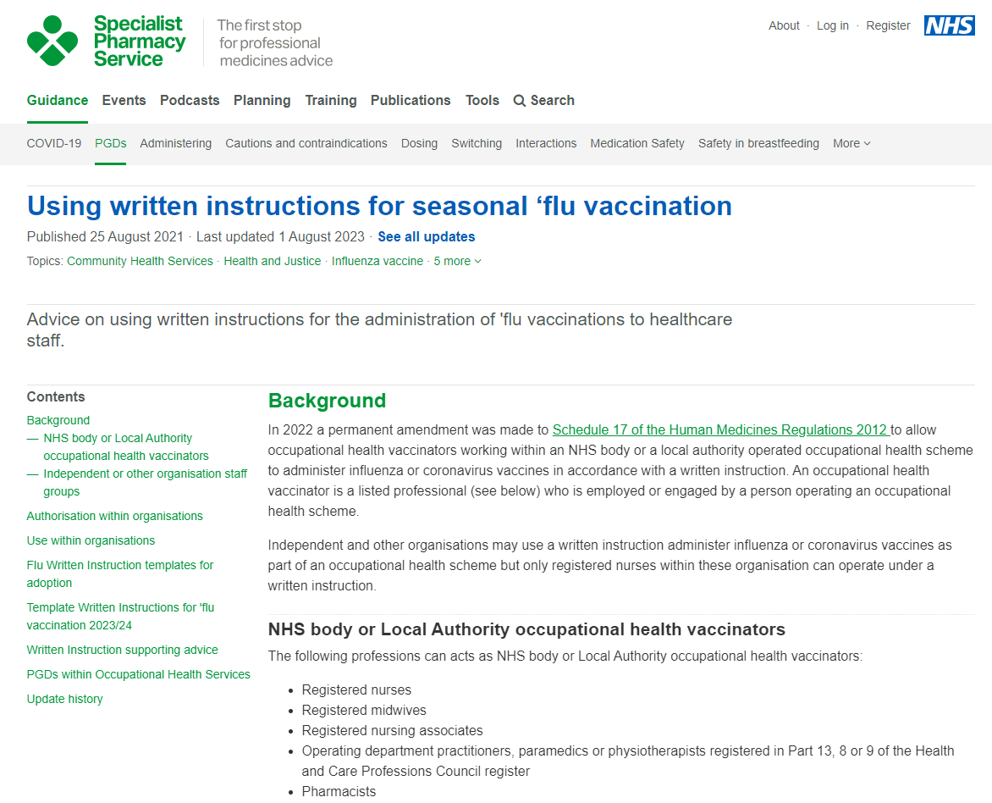
| Written Instruction for the administration of seasonal ‘flu vaccination
https://www.sps.nhs.uk/articles/using-written-instructions-for-seasonal-flu-vaccination/

Slide 16
General Practice best practice guidance: Increasing flu immunisation uptake amongst pre-school children
www.gov.uk/government/publications/flu-vaccine-best-practice-guide-for-gps
Product code: TBC
Download only

Slide 17
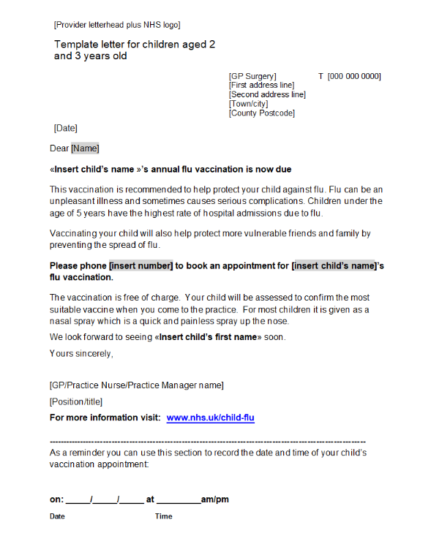
| Pre-school resources will be uploaded shortly
Product code: TBC
Download only
www.gov.uk/government/publications/flu-immunisation-for-early-years-settings-including-child-minders
www.gov.uk/government/publications/flu-vaccination-invitation-letter-template-for-children-aged-2-3-and-4-years

Slide 18
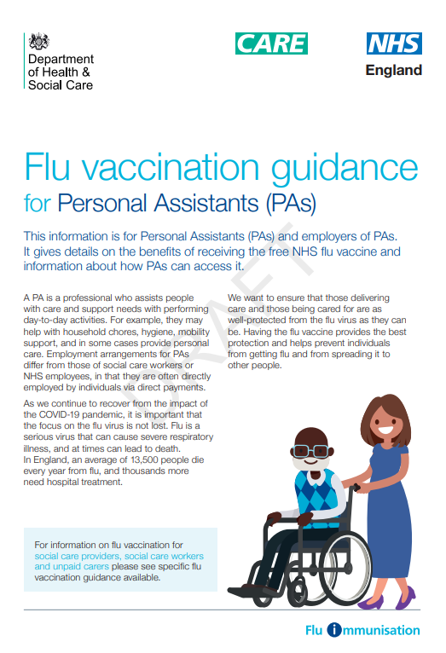
| Social care resources – will be available shortly
www.gov.uk/government/publications/flu-immunisation-for-social-care-staff

Slide 19
| Resources to support the flu programme
Public Facing

Slide 20
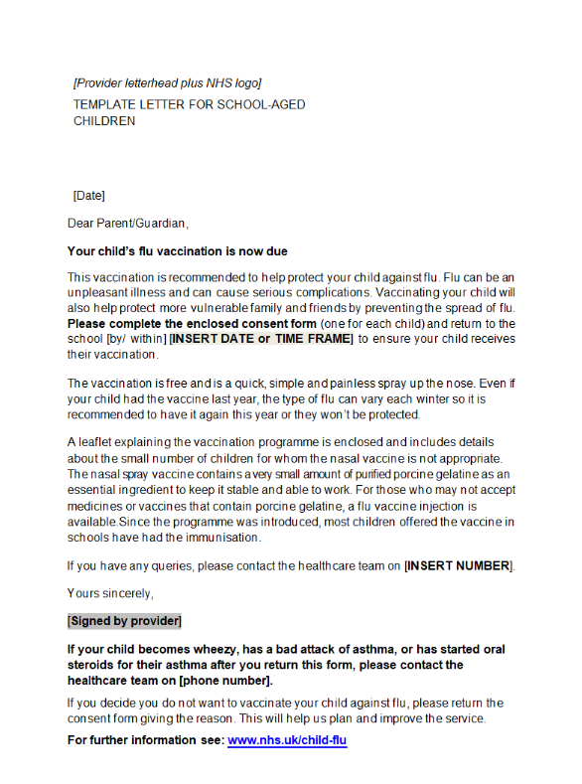
| Primary school resources www.gov.uk/government/publications/flu-vaccination-in-schools
Product code: 2023FBS1
Product code: SCHFLSTK
Invitation letter link
https://www.healthpublications.gov.uk/ViewProduct.html?sp=Sflustickersforchildrenaged2to11years

Slide 21
| Primary school resources
Protect your child against flu – information for parents and carers of children in primary school
Paper copies of this leaflet are available to order for free or download in the following languages:
English, Albanian, Arabic, Bengali, Bulgarian, Chinese (simplified), Chinese (traditional, Cantonese), Estonian, Farsi, French, Greek, Gujarati, Hindi, Latvian,
Lithuanian, Panjabi, Pashto, Polish, Portuguese, Romanian, Romany, Russian, Somali, Spanish, Tagalog, Turkish, Twi, Ukrainian, Urdu and Yiddish.
An English large print version is available to order.
A Braille version of this leaflet is available to order.
A British Sign Language video of this leaflet is available to view.
This British Sign Language video is also available to download.
An audio version is available to download.
Please note:
the images on the translated and alternative versions differs to the English version
Product code: 2023FCEN
https://www.healthpublications.gov.uk/ViewProduct.html?sp=Sfluvaccinationprimaryschoolforparents

Slide 22
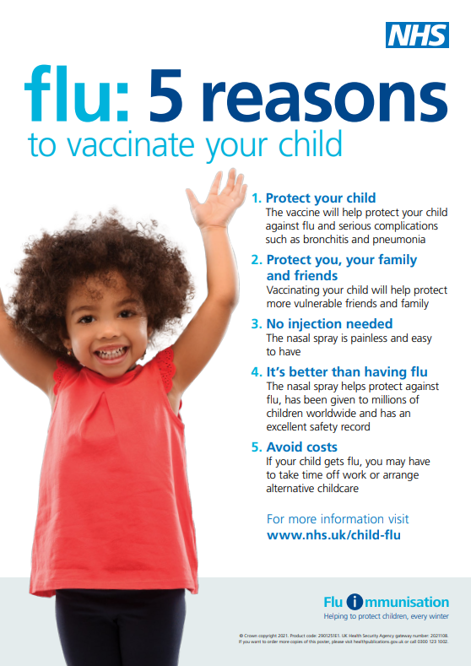
| Primary school resources
5 reasons to vaccinate your child against flu poster for primary schools and pre-schools
This poster is available free to order in the following languages:
English, Albanian, Arabic, Bengali, Brazilian Portuguese, Bulgarian, Chinese, Estonian, Farsi, Greek, Gujarati, Hindi, Latvian, Lithuanian, Panjabi, Polish, Romanian, Romany,
Russian, Somali, Spanish, Turkish, Twi, Ukrainian, Urdu and
Yiddish.
Product code: 2901251E1
https://www.healthpublications.gov.uk/ViewProduct.html?sp=Sflu5reasonstovaccinateyourchildposter011years

Slide 23
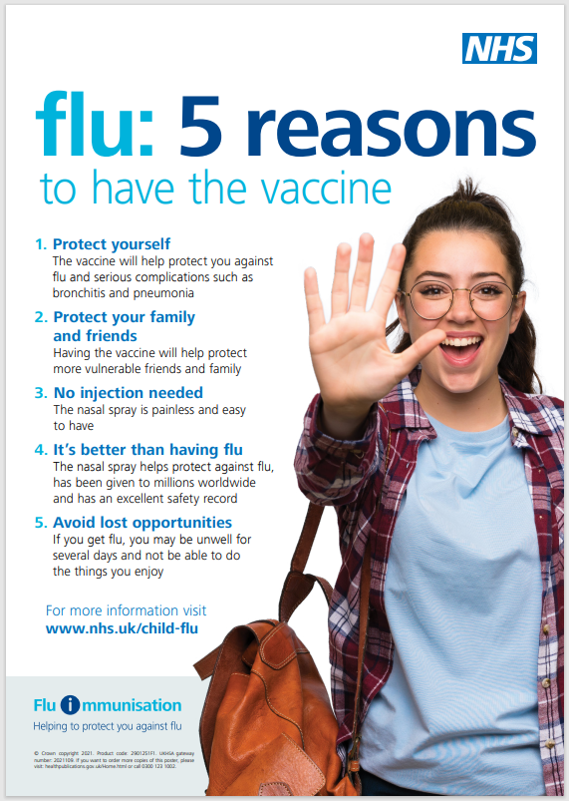
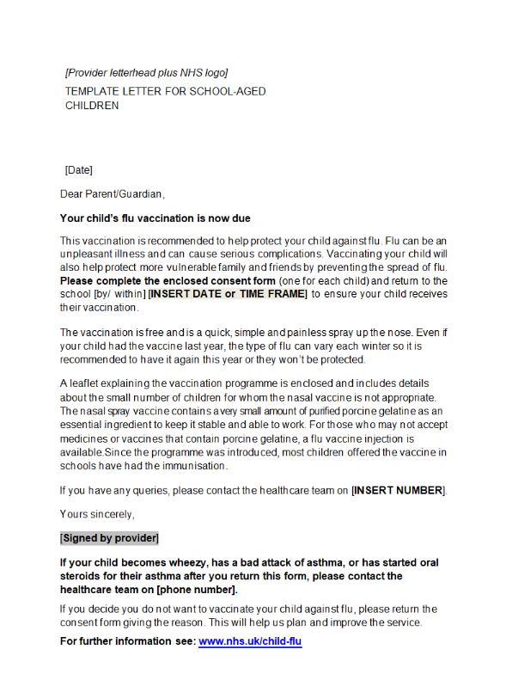
| Secondary school resources
Product code: 22SECFLUEN
Product code: 2901251F1
https://www.healthpublications.gov.uk/ViewProduct.html?sp=Sprotectyourselffromflusecondaryschoolenglish
https://www.healthpublications.gov.uk/ViewProduct.html?sp=Sflu5reasonstovaccinateyourchildposter1117years
www.gov.uk/government/publications/flu-vaccination-in-schools

Slide 24
| Secondary school resources
Paper copies of this leaflet are available to order for free or download in the following languages:
English, Albanian, Arabic, Bengali, Bulgarian, Chinese (simplified), Chinese (traditional, Cantonese), Estonian, Farsi, French, Greek, Gujarati, Hindi, Italian, Latvian, Lithuanian, Panjabi, Pashto, Polish, Portuguese, Romanian, Romany, Russian, Somali, Spanish, Tagalog, Tigrinya, Turkish, Twi, Ukrainian, Urdu, Yiddish and Yoruba.
A Braille version of this leaflet is available to order.
An audio version is available to download.
A British Sign Language video of this leaflet is available to download.
Product code: 22SECFLUEN
https://www.healthpublications.gov.uk/ViewProduct.html?sp=Sprotectyourselffromflusecondaryschoolenglish

Slide 25
| Secondary school resources
5 reasons to vaccinate your child against flu poster for secondary schools
English, Albanian, Arabic, Bengali, Brazilian Portuguese, Bulgarian, Chinese, Estonian, Farsi, Greek, GujaratiHindi, Latvian, Lithuanian, Panjabi, Polish, Romanian, Romany, Russian, Somali, Spanish, Turkish, Twi, Ukrainian, Urdu,Yiddish.
www.gov.uk/government/publications/flu-vaccination-in-schools
Product code: 2901251F1
https://www.healthpublications.gov.uk/ViewProduct.html?sp=Sflu5reasonstovaccinateyourchildposter1117years

Slide 26
Briefing for secondary schools on adolescent vaccination programme
This guide explains the different adolescent NHS vaccination programmes delivered to children in secondary schools and the important role that schools play in the delivery of these programmes. It includes information on the flu vaccination programme.
Product code:
FLU23SC Download only

Slide 27
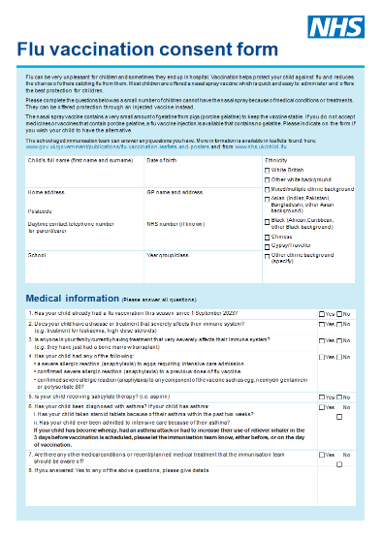
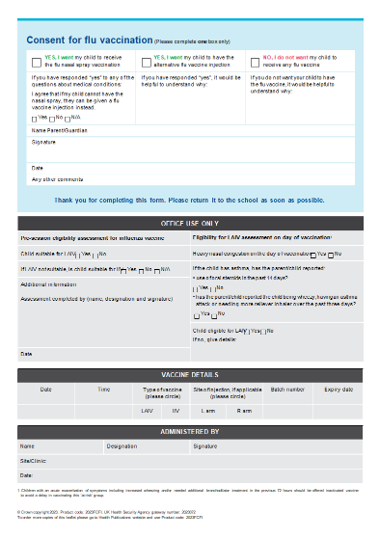
| Flu vaccination consent form (combined form for nasal spray and injectable vaccine)
www.gov.uk/government/publications/flu-vaccination-in-schools

Slide 28
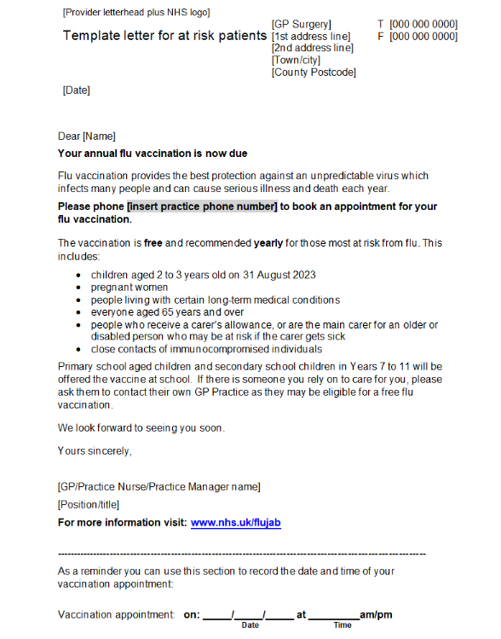
| All eligible groups
Flu vaccination: who should have it this winter and why
Paper copies of leaflet are available free to order or download in the following languages:
Albanian, Arabic, Bengali, Bulgarian,
ChineseTraditional, ChineseSimplified, Estonian,
Farsi, French, Greek, Gujarati, Hindi, Italian,
Latvian, Lithuanian, Panjabi, Pashto, Polish,
Portuguese, Romanian, Romany, Russian, Somali, Spanish, Tagalog, Tigrinya, Turkish, Twi, Ukrainian, Urdu, Yiddish and Yoruba
Copies will also be available in accessible formats including audio, braille, British Sign Language (BSL) video and large print.
www.gov.uk/government/publications/flu-vaccination-who-should-have-it-this-winter-and-why
Product code: F23MW1
www.gov.uk/government/publications/flu-vaccination-invitation-letter-template-for-at-risk-patients-and-their-carers
https://www.healthpublications.gov.uk/ViewProduct.html?sp=Sthefluvaccinationwhoshouldhaveitandwhy

Slide 29
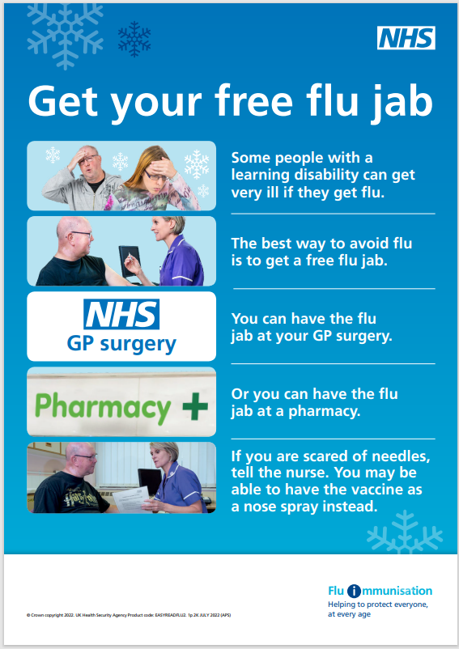
| Easy read for those with a learning disability
Product code: EASYREADFLU2
Product code: EASYREADFLU1
https://www.healthpublications.gov.uk/ViewProduct.html?sp=Sprotectyourselffromflueasyreadleaflet
https://www.healthpublications.gov.uk/ViewProduct.html?sp=Sprotectyourselffromflueasyreadposter

Slide 30
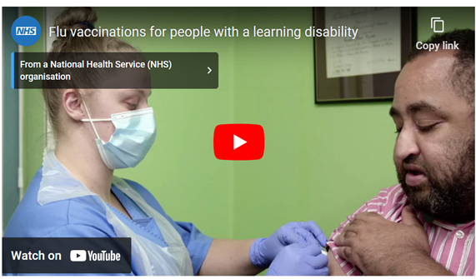
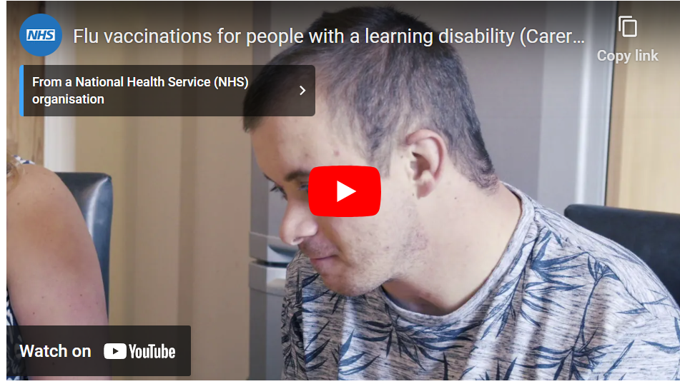
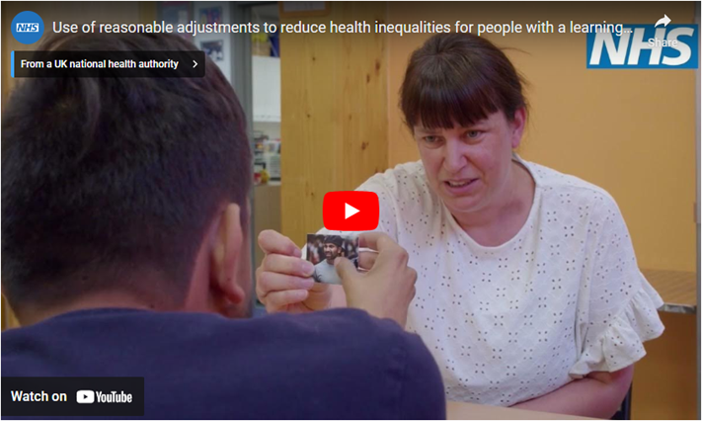
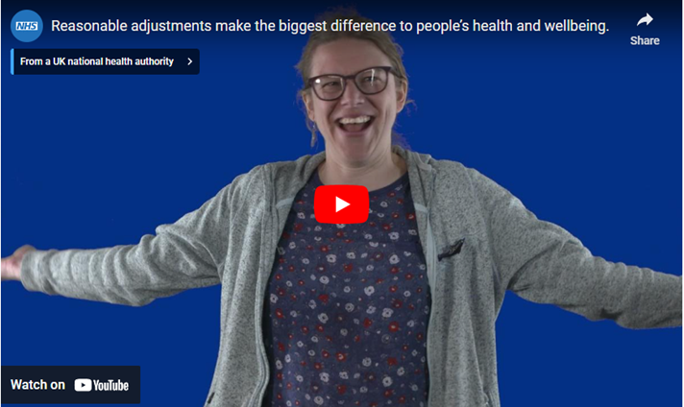
Flu vaccination films for people with a learning disability and autistic people and their family or carers
Flu vaccination video for people with a learning disability
Flu vaccinations for carers of people with a learning disability
www.gov.uk/government/publications/flu-leaflet-for-people-with-learning-disability
YouTube links:
https://www.youtube.com/watch?v=OqGSm0jaF9A
https://www.youtube.com/watch?v=jJ9QdwUitFg
Use of reasonable adjustments to reduce health inequalities video
How reasonable adjustments make a big difference to health and wellbeing video
www.england.nhs.uk/learning-disabilities/improving-health/reasonable-adjustments/

Slide 31
| Simple text resources for those with low literacy
Product code: FLU2021STA
Product code: FLU2021STC
https://www.healthpublications.gov.uk/ViewProduct.html?sp=Sfluvaccinationsimpletextadultleaflet
https://www.healthpublications.gov.uk/ViewProduct.html?sp=Sallaboutfluandvaccinationsimpletextforchildren

Slide 32
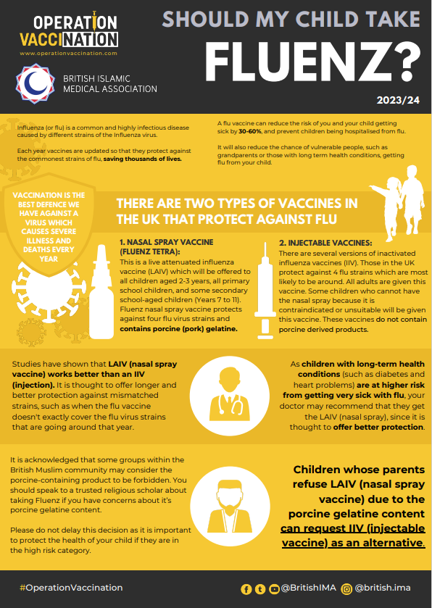
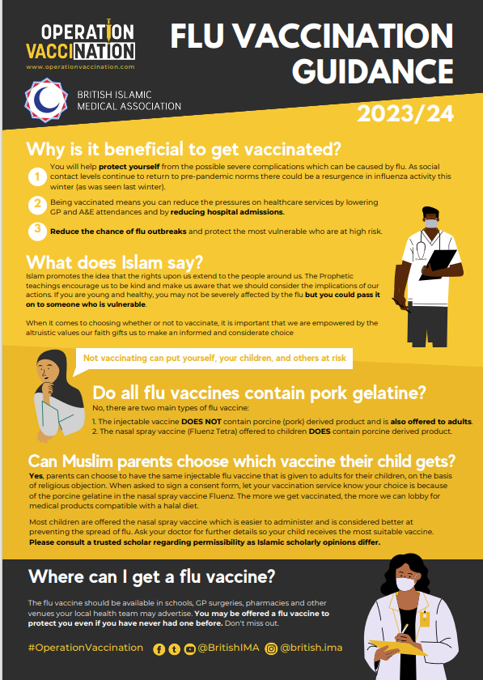
British Islamic Medical Association Flu Resources
The British Islamic Medical Association (BIMA) have produced 2 resources which explain the benefits of flu vaccination, the Islamic position on taking up the vaccine, and how to weigh up whether your children should have the nasal spray vaccine given the porcine gelatine content and conflict with a halal diet. BIMA are happy to be contacted for any local queries on info@britishima.org and you can download these resources from: https://britishima.org/guide/flu-vaccines-update-23/

Slide 33
| Weblinks
Healthcare professionals
www.gov.uk/government/publications/influenza-the-green-book-chapter-19 (for ‘Green Book’ chapter 19)
www.gov.uk/government/collections/immunisation-patient-group-direction-pgd#seasonal-influenza (for inactivated and LAIV PGDs)
www.gov.uk/government/publications/national-protocol-for-inactivated-influenza-vaccine (national protocol)
www.e-lfh.org.uk/programmes/flu-immunisation (flu immunisation e-learning programme)
www.government/publications/flu-vaccination-programme-information-for-healthcare-practitioners (information for healthcare practitioners)
Public facing
www.gov.uk/government/collections/annual-flu-programme (resources on GOV.UK)
https://campaignresources.dhsc.gov.uk (for marketing resources on the Campaign Resource Centre).
www.nhs.uk/flujab (NHS website)
www.healthpublications.gov.uk (Health publications ordering)
Surveillance data
www.gov.uk/government/statistics/national-flu-and-covid-19-surveillance-reports-2023-to-2024-season (weekly disease surveillance reports)
www.gov.uk/government/collections/vaccine-uptake#seasonal-flu-vaccine-uptake:-figures (current and previous seasons flu vaccine uptake figures)
www.gov.uk/government/publications/respiratory-virus-circulation-england-and-wales/timing-of-influenza-seasons (timing of flu seasons)

