Slide 1
Leeds LMC & PCSE Roadshow
20/05/2019
Sophie Meek & Julie Powdrell

Slide 2
Agenda
Performers List
GP Pensions
Urgent Medical Records
Registration User Guide
List Reconciliation
List Cleansing
GP Bulletin
Customer Thermometer
The Role of PCSE
Open Exeter
Practice Mergers and Closures
GP Payments
Data Quality Checks on GP Lists

Slide 3
We administer the following services for GPs:
The Role of Primary Care Support England
PCSE
GP Practice Mergers and Closures
Access for Open Exeter
Patient Registrations
Performers List
GP Pensions
GP Payments
Medical Records
Practice Supplies

Slide 4
Performers List
NPL1
Applying to join the Performers List for the first time
NPL2
Moving to a different NHS England team
NPL3
Change of circumstance or status (name, address, status or practice within same locality)
Confirmation letters are emailed back to the email address provided on the NPL form or our customer database
The subject title is key! Please ensure NPL1, NPL2 or NPL3 stated on email to ensure your case is triaged correctly

Slide 5
Performers List
Process – Notification of change of role
1
Submitting a change notification
Submission
Who can send the application in
Acknowledgment
2
Collecting change information
To enable the application to be completed, PCSE will need to contact 3rd party organisations:
Leaving practice
Joining practice
CCGS for single handed practices
NHS England Local Office
3
Update Systems
Once all necessary information & documentation is received PCSE will update appropriate NHS systems

Slide 6
Performers List
Process – Notification of change of role
4
Notification of changes
PL team will notify:
The performer
NHSE Local office
PCSE registrations team (if relevant)
NHSBSA
PL Team hand to Pensions Team
Confirmation of changes
Change of confirmation letter received by performer - this includes all codes to update practices clinical systems
New practice requirements:
Submit an Estimate of GP NHS Pensionable Profits/Pay via the PCSE online form
NOTE: Please state that the estimate is being submitted in relation to a recent performers list change.
**The Estimate of GP NHS Pensionable Profits/Pay should include all GPs, salaried and GP Partners, and not just be for the new GP joining the practice**
5

Slide 7
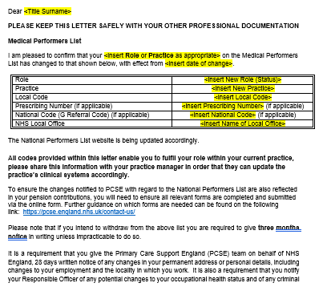
Performers List
Example confirmation of change letter
Your new Prescribing details

Slide 8
GP Payments
What we are responsible for
A few examples of what our team are responsible for:
Running Global Sum payments
PMS contract baseline payments
Childhood immunisation
Our team process the payment contract schedules for the following but any queries will need to be directed to the commissioner:
Rent and rates
Maternity locum payments
Full list of responsibilities is available on our website:
https://pcse.england.nhs.uk/services/gp-payments/

Slide 9
Examples of what our team are responsible for:
GP Pensions
What we are responsible for
Receive estimate of profit for principal partners, salaried GPs and non-clinical partners to determine their contributions and tier rate
Process retirement applications
Receive GP year end actual profit certificates and processing on NHAIS
Make deductions from remunerations
Respond to GP Pension Queries
Make the necessary pensions adjustments on receipt of the processed NPL form
Full list of responsibilities is available on our website:
The following are the responsibility of NHSBSA:
Provide pension statements
Generate Total Reward Statements
Pay NHS pensions
https://pcse.england.nhs.uk/services/gp-pensions/

Slide 10
The Pensions Year-End Process
By 28 February GPs need to return either:
Type 1 GP Provider Annual Certificate of Pensionable Income
Type 2 Medical Practitioner Self-Assessment Form
Please submit via online form:
www.pcse.england.nhs.uk/contact-us/
This is a legal requirement
PCSE will update Pensions Online on receipt of full and complete documents
If deadline missed for current or previous years, information may not be visible on TRS
Important for GPs to complete forms, even if deadline has passed

Slide 11
38,540
Total forms received by PCSE this year (as of 29/04)
25,179
Type 1 Certificates
10,913
Type 2 Certificates
2,448
Amnesty Forms
Year-End
Volumes to date
5,332
Practice Estimate Forms

Slide 12
Timescales for Processing agreed with NHS England (for this year)
This year not all certificates will be processed within our standard 61 day timescale
This is due to an agreement made with NHS England to process historical annual certificates and Type 2 amnesty forms in order to bring all GP pension records up to date
Order of processing
We will let all GPs know when their documents have been processed and updated on Pensions Online
Historical years forms and certificates sent before 4th March 2019
Historical years forms and certificates sent after 4th March 2019
Those completed by 21st June 2019 will be visible on the August 2019 Total Reward Statement (TRS)
Forms and certificates for 2017/18
Those completed after this date will be visible on the December 2019 TRS

Slide 13
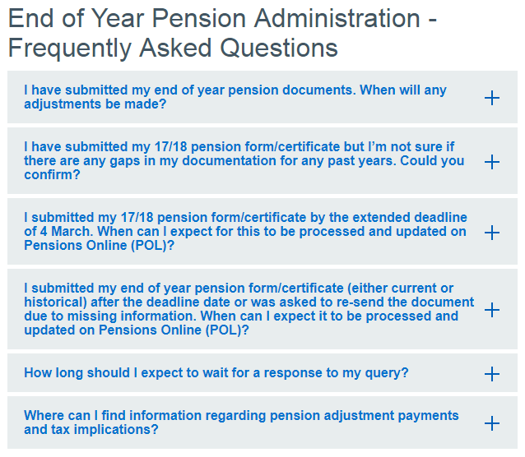
Frequently Asked Questions
An extensive set of FAQs can be found on the ‘Help’ page of the PCSE website:
https://pcse.england.nhs.uk/services/gp-pensions/

Slide 14
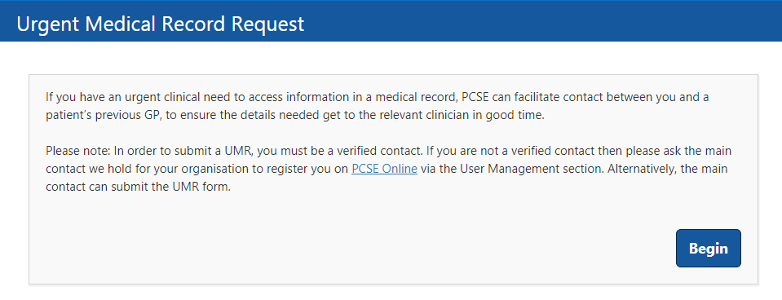
Urgent Medical Records
Online Form
New online form for requesting UMRs
https://pcse.england.nhs.uk/contact-us/
Quick and easy to complete
Information is validated as entered
Ensures all required information is captured
Email to confirm submission and case reference number

Slide 15
Urgent Medical Records
The Process
1
PCSE receives urgent medical record online form submission
2
Within two working days
PCSE contacts previous practice asking them to forward the summary to the requestor as soon as possible via email or fax
Please note: this process does not move the paper record quicker than the normal record movement process
PCSE will request the electronic and paper medical records from the previous practice once, unless we are asked to do so again by the requesting practice.
3
Within 14 days
A tracking label for the paper record is generated and delivered to the previous practice
4
CitySprint will collect the paper record once made available by the practice
5
Within seven working days
CitySprint will deliver the paper record to the requesting practice via normal record movement process

Slide 16
What it will include:
How is patient registration information updated?
Overview of the Registrations process
Using the High Security setting on your practice clinical system
GP Links and GP Codes
Confusions and duplicates
Tips for smooth patient registrations
Common reasons for rejection of patient registrations
Guidance on Residential Institute (RI) Codes
Requesting the removal of patients from your practice list
Process for registering an adopted patient
Process for registering a patient gender re-assignment
Registration User Guide
Please ensure to check our website for future changes to this guide
https://pcse.england.nhs.uk/services/registrations

Slide 17
Data Quality Checks on GP Lists
PCSE has begun contacting GP practices to conduct data quality checks on practice lists, on behalf of NHS England
It is critical main contacts are up to date and include nhs.net email addresses due to communication of patient identifiable information
Communications involving data quality checks will be sent by email to the main contact we hold at each practice
You can change/update the practice main contact by using our online enquiries form - select ‘Register for PCSE Online’ as the subject enquiry type and include:
Practice name
Organisation type (GP)
The organisation/ODS code for your practice
Name of old and new main contact
Email address for old and new main contact
Practice address
Practice telephone number
We will contact you once received to verify details

Slide 18
List Cleansing
As per NHS policy guidelines:
Practices will receive email instructions from PCSE outlining steps needed to take
Small number of GP practices contacted to verify the registration details of patients aged over 100
Process expected to be rolled out nationally to all practices in England from May 2019
Other patient group checks will follow, including:
NHS England guidance on the policy for managing patient lists can be accessed in section three of the NHS England Primary Medical Care Policy and Guidance manual (PGM) available here:
https://www.england.nhs.uk/publication/primary-medical-care-policy-and-guidance-manual-pgm/
patients aged under 16 recorded as living alone
patients recorded as living in demolished properties
patients recorded as being registered at student accommodation for over four years
addresses with apparent multiple occupancy
transient patients.

Slide 19
List Reconciliation
PCSE has started contacting practices regarding patient list reconciliation
PCSE requests copy of practice’s patient list from their clinical system
Practice patient list compared with the practice patient list held on NHAIS
A set of actions will be sent to the practice to align both lists
3 year rolling cycle
NHS England Requirement:
Practices are asked to respond within 10 days
We are required to notify commissioners in circumstances where we have been unable to reconcile lists with practices

Slide 20
Open Exeter
What we do
Our team are responsible for:
Creating new organisations / users and removing accounts no longer needed
Resetting passwords of existing users
Updating permissions
Processing practice merger/closures on Open Exeter by updating users & permissions
Any queries relating to the examples below should be raised with the relevant service line:
Full list of responsibilities is available on our website:
Payments
Open Exeter pensions related data
Patient related data
Childhood Immunisation payments
https://pcse.england.nhs.uk/services/open-exeter/

Slide 21
1
Practice mergers & closures
Notification form can be downloaded from our website
https://pcse.england.nhs.uk/media/1091/pcse-practice-mergers-closures-form-v09.doc
2
Approval required by the delegated CCG & NHSE RLT
3
Once approval from RLT received forward to PCSE
4
PCSE will also require
NPL3
Pensions Estimation Forms
Banking Declaration Form
FAQs can be found on our website
https://pcse.england.nhs.uk/help/gp-payments/practice-mergers-and-closures/

Slide 22
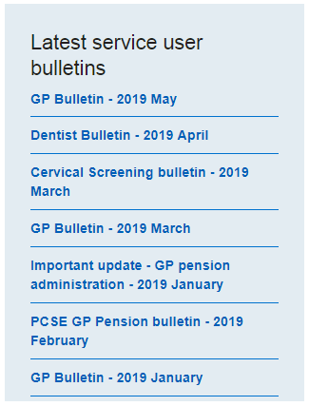
GP Bulletin
Highly useful source of information
Regularly emailed to the main contact of every practice
Main contact details must be correct and up to date
If you need to notify us of changes to your main contact, please use our online query form, selecting ‘Register for PCSE Online’
https://pcse.england.nhs.uk/register/
All bulletins can also be found on the PCSE website
https://pcse.england.nhs.uk/news/

Slide 23
Customer Thermometer Survey
You will start to see gold, green, amber and red stars appear whenever you contact PCSE
Excellent!
Good
Just OK
Poor
Survey currently in pilot
Feedback should given for the current interaction with PCSE
One click is all it takes to let us know how you have found the support that has been given to you

Slide 24
Customer Support Centre: 0333 014 2884
Website: www.pcse.england.nhs.uk
For queries relating to a particular service, please use our online enquiries form: www.pcse.england.nhs.uk/contact-us
Address: Primary Care Support England, PO Box 350, Darlington, DL1 9QN

