Slide 1
Climate Change: The Primary Care impact
What action can GP’s take?
Dr Honey Smith, Chair of Greener Practice National

Slide 2
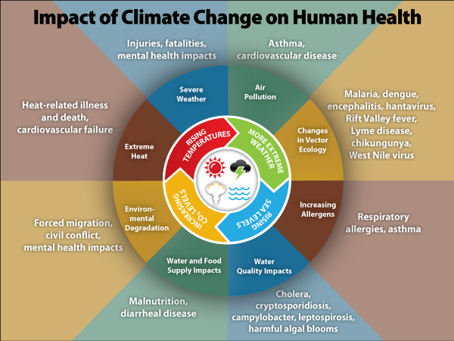

Slide 3
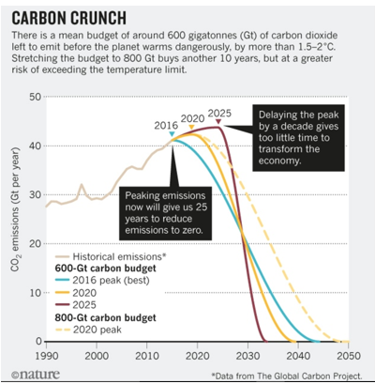

Slide 4
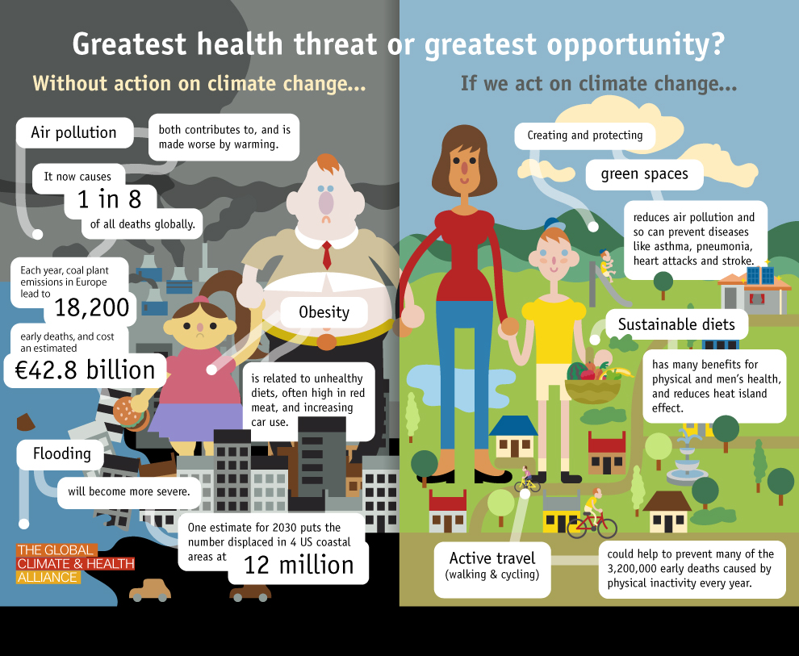

Slide 5
NHSE and Net Zero
Net Zero direct emissions by 2040
Indirect emissions by 2045

Slide 8
Carbon hotspots in General Practice

Slide 9
Sustainable Health Care
Health promotion / disease prevention
Patient empowerment
Lean service delivery
Low carbon alternatives

Slide 10
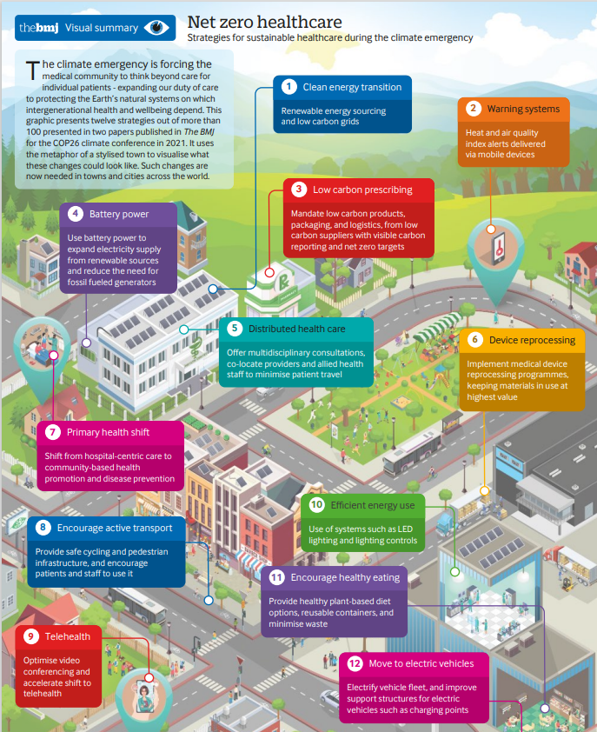

Slide 11
Low carbon, excellent asthma care

Slide 12
Low Carbon, Excellent Asthma Care
Reducing SABA over-reliance
(<3x/ week)
Inhaler technique
Personalised asthma action plans
Inhaler type

Slide 13
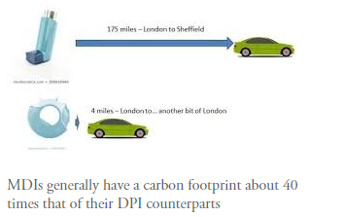

Slide 14
MDIs vs DPIs
MDIs 70% of inhaler prescriptions in the UK , 13% in Sweden
90% of relievers in Sweden prescribed as DPIs
Switching to Swedish pattern usage would save 550 kt Co2e / year in England
Dose counters mean less wastage
Inhaler technique easier for most patients

Slide 15
Other considerations with inhalers
Salamol MDI has half the carbon footprint of Ventolin evohaler
Flutiform and Symbicort MDIs have particularly high carbon footprints
Use one puff of 200mcg rather than 2 puffs of 100mcg if possible
Inhaler recycling?
Return to pharmacy for disposal if no recycling available

Slide 16
Prescribing
Using alternatives to medication - dietary improvements, exercise, social and green prescribing
Reducing unnecessary / harmful prescribing
Reducing waste eg medication over- ordering (“Show Me Your Meds project”)
Using low carbon alternatives eg low carbon inhalers

Slide 17
Anticholinergic Burden QI project
High anticholinergic burden associated with a number of significant adverse health effects
Especially falls, cognitive decline, increased mortality
ACB score >3 considered high risk

Slide 18
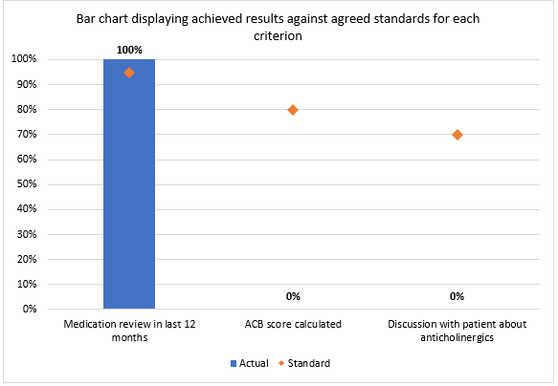

Slide 19
Reducing anticholinergic burden
Pharmacy technician does an ACB score on patients>70 on >10 medications at time of medication review
Pharmacy technician highlights any ACB score>3
Doctor / practice pharmacist discusses risks with patients and explores plan to reduce ACB drugs

Slide 20
Non-drug Interventions to support healthy living
Active travel
Green and blue prescribing – gardening, green gym, nature walks, mindfulness in nature
Planetary health diet
Breathing exercises, pulmonary rehab
Tai Chi (outdoors?) or other exercise class
Addressing fuel poverty (grants for insulation etc)

Slide 21
Patient (and staff) travel
Lean pathways
Remote consulting
Use of technologies
Supporting active travel to surgery
Health professionals as role models of active travel

Slide 22
Medical equipment
Reusable PPE
Reducing couch roll and glove usage
Sterilising services for surgical instruments
Sending unwanted medical equipment to medical charities abroad

Slide 23
Sustainable QI
“Triple bottom line” –Considers financial, social and environmental cost of an intervention or organisation
See healthcare through a “planetary health” lens
Planetary health curriculum on trainer / trainee HEE website
www.susqi.org/step-by-step-guide

Slide 24
Green Impact for Health Toolkit
https://www.greenimpact.org.uk/giforhealth
Guest login gifh@greenimpact.org.uk
password Testtoolkit1!
Voluntary donation £25 to join

Slide 25
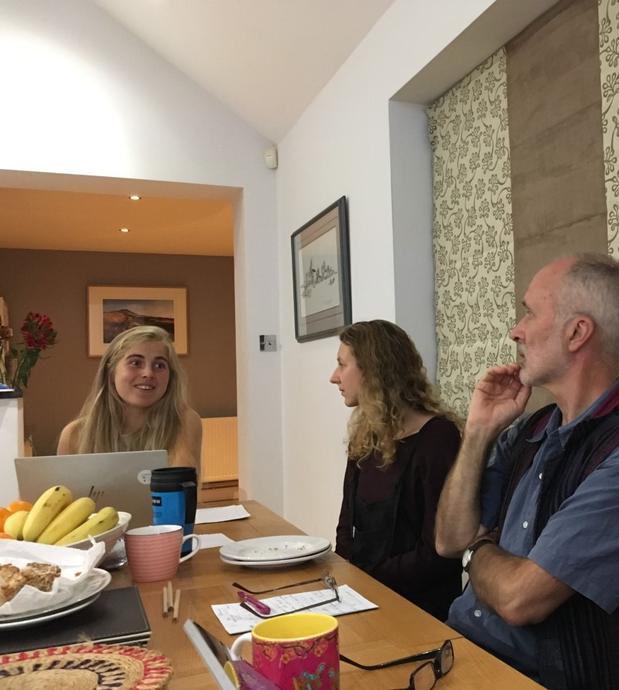
Join, or form, a Greener Practice group locally
18 groups around the country so far
More groups under consideration
Powerfully supportive network
Informal drop-in meetings to support new leaders
Share best ideas and stop reinventing the wheel!
Local leads invited to national quarterly meetings
Regular free educational meetings for groups

Slide 26
What we have learned along the way
Only a small number of people needed to get a group started
Use Thinking Time principles for meetings
Go with the natural enthusiasms of the members
Work with your LMC, PCN, ICS, RCGP Faculty
Get support from other leaders in Greener Practice
Invite Medicines Optimisation Team, secondary care colleagues etc to form shared goals

Slide 27
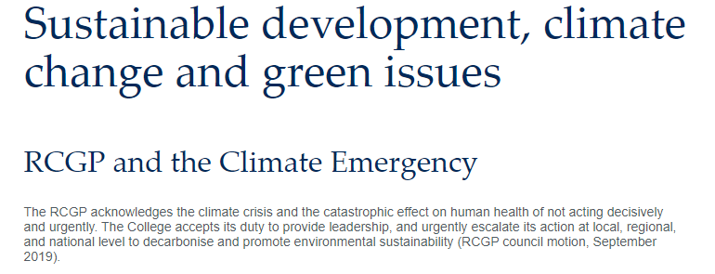

Slide 28
WhatsApp groups
National
Respiratory
Clinical
Working with organisations
Clinical care
Education
GIfH toolkit and QI

Slide 29
Advocate for Climate Action

Slide 30
Upcoming Events
Sharon Pfleger – Medicines and the Environment - 13th Dec 21
Deb Gompertz- Show Me Your Meds (Please!) – 25th Jan 22

Slide 31
www.greenerpractice.co.uk greenerpractice@gmail.com twitter @greenerpractice Twitter handle @greenerpractice

