Slide 1
Climate Action Leeds
Dr Nicola Hambridge
Chair Leeds LMC & Volunteer Director Leeds Tidal

Slide 2
Our story so far
A 5-year programme of climate emergency community action
Successful bid to National Lottery Climate Action Fund
40 organisations contributed to the bid
5 delivery partners: Voluntary Action Leeds, Leeds Love It Share It,
Together For Peace, Leeds Tidal, CAG Consultants
Supported by Our Future Leeds
Notes:
Leeds groups and organisations have been active around climate for many years
urgent climate challenge can only be met through collaboration and a whole systems approach that mobilises the entire city.
Climate Action Leeds was successfully awarded £2.5 million by the National Lottery and was set up in 2020.
The idea and structure for Climate Action Leeds emerged from the activities of Our Future Leeds which acts as an independent strategic partner, offering guidance and support, as well as lobbying and advocacy work for this programme.

Slide 3
Our aims
A zero carbon, nature friendly, socially just Leeds by the 2030s.
Building on Leeds’ existing strengths in climate justice - Climate Emergency Advisory Committee (2019), carbon roadmap, Leeds and YH Climate Commissions
Supporting communities to engage with transformative action that meets the challenges ahead
Mobilising communities, groups and sectors to plan and act together across the city
Building a movement of connected, engaged communities
Notes:
For Climate Action Leeds HOW we do this is inseparable from WHAT we want to achieve – and we use a movement-building ethos based on informing, empowering, connecting and mobilising communities to plan and act strategically across the city.
underpinned by a set of core values around enabling and hearing different voices, and recognising and addressing inequalities - be it of access, of information, of status, power or experience. Our community-centred work recognises that those who are most affected by issues will also be best placed to find the solutions. Climate change impacts the most vulnerable members of society most, so the response has to be embedded in social justice - both locally and internationally.

Slide 4
What we’re doing
1. Community Hubs
4 hubs up and running in: Seacroft, Garforth, Otley and Beeston
Next hubs currently being set up in Armley, Alwoodley, Horsforth and Little London
8 further mini-hubs in additional communities to come
Cash grants to support local climate initiatives
Local action plans will be developed
Notes:
The bedrock of Climate Action Leeds is the local community hubs, which will be based in 8 communities across Leeds to facilitate community-led climate action within neighbourhoods.
These hub areas are being selected carefully to reflect the diversity of different communities in Leeds: e.g.- market towns, inner city, outer suburbs, and many more. In each area we are supporting residents to develop a local climate action group that we support and work with to create their own community climate action plan, based in local priorities.
When they are ready, our budget allows for financial support for their activities agreed in their plan and the employment of a local Hub worker for 3 years (2 days pw) to support the group, Hub and activities.
Because of Covid restrictions, most of the engagement work has been online. This has not been as difficult as we feared, but it has certainly been slower than hoped in some areas as a result. Our approach has been to contact local stakeholders; community groups, voluntary organisations, council staff and councillors and other public services, whilst ensuring that residents are at the centre and the process is resident-led. All areas now have residents involved who are either on or expressing interest in being on a steering group to become a climate action group, and are working or about to start on final development phases, of the hubs becoming operational with local development workers in place.
In addition, our programme of support and grants for smaller projects will start in October this year. These will be available to communities, groups and projects city wide
Climate Action Leeds other strands of work support and inform the work of the hubs, and in turn insights and actions from the community hubs help us develop our city scale work. Overall, we want these community climate action hubs to be a catalyst for city wide change and to inspire others to set up similar projects.

Slide 5
What we’re doing
2. City Hub
Collective imagining & planning space for Leeds’ people and its future
Collaboration, sharing, resources, participation
Physical/ virtual
Working with Climate Emergency Centres
Actively finalising a city centre space now
Notes:
City hub
As well as hubs based in different community settings, our programme of work involves setting up a hub in Leeds city centre. This is a place for the whole project to come together.
It will take different forms at different times. We aim to hold workshops, skill sharing events, drop in sessions and exhibitions, to find different, creative, playful, fun and sometimes challenging ways to bring new and diverse people into the conversation.
Our ultimate aim is to see a permanent venue where the public can come and learn more about Leeds and the challenges it faces, and play an active part in envisaging their city and shaping its future.
This space will become a central planning and action room for how we tackle the climate emergency and build a community based and just transition.
Our original space is sadly no longer an option however, so we are exploring alternatives with partners such as the city centre BID team and the national Climate Emergency Centres network.

Slide 6
What we’re doing
3. Climate Assemblies
Twice each year in April and October
Open, cross-sector event where Climate Action Leeds engages with the broader community of Leeds with the aim to share, learn and plan together
A chance to come together, network, plan and celebrate the progress being made towards climate justice
Open to anyone and everyone interested in the climate emergency
Notes:
The Climate Assembly is a roundtable event that takes place twice a year, and it plays a critical role in the structure of the programme. The Assembly is an open, cross-sector event where Climate Action Leeds engages with the broader community of Leeds with the aim to share, learn and plan together.
This could see faith groups, business leaders, school children and activists all taking their place in a shared conversation, finding connections and creating plans for all their mutual benefit.
We will facilitate this opportunity for outreach, cross-fertilisation of ideas, support and networking beyond and across sectors, projects and organisations within Leeds and further afield.
It is an event to celebrate progress too, but also to focus on how we tackle the real challenges ahead - together.

Slide 7
What we’re doing
4. Transition Partners
Partner organisations separately addressing themes of:
food, housing, nature, energy, youth & education, work & economy, transport
Climate justice partnership with Racial Justice Network
- Each partner hosts thematic assemblies and develops their own plan
Notes:
As well as communities of place, there’s an important role for communities of interest or experts, and these are represented by our 7 Transition Partners appointed for the thematic areas of food, housing, nature, youth and education, work and economy, energy and transport.
These partners act as sector organisers, inspiring and organising change - acting as hubs which bring together experience, insights and action in their areas, and sharing this with the community hubs.
They will host regular assemblies in their particular field and work towards developing a sector plan on their theme – and they will be able to connect with the CEAC groups too.
We also are talking with and learning from the Racial Justice Network about how to ensure that climate justice is inextricably part of what we do.

Slide 8
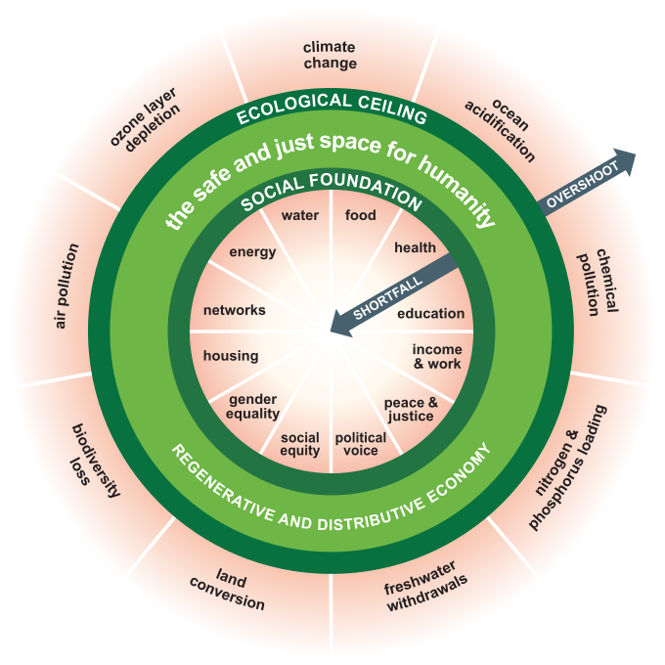
What we’re doing
5. The Leeds Doughnut
“Doughnut Economics is a compass for human prosperity in the 21st century, with the aim of meeting the needs of all people within the means of the living planet.”
Notes:
All the different Programme elements will feed into an over-arching City Plan, which will provide a framework for how we see the direction of Leeds over the next few years. We are using the approach of award winning economist Kate Raworth and her Doughnut Economics Action Lab on developing this plan.
In short, Doughnut Economics is a compass for human prosperity in the 21st century, with the aim of meeting the needs of all people within the means of the living planet.
This approach asks how can people in a particular place thrive without exceeding and damaging planetary boundaries (of carbon, water, air, soil etc), and without falling below aspects that ensure a good life (education, health, democracy, equality etc).
A thriving Leeds within ecological and social boundaries.
Powerful visual tool to connect all the different areas contributing to climate justice in the city
We call this the Leeds Doughnut, where we aim to live in safe and thriving space inside the doughnut!
An approach that has gained global recognition and support, with cities and regions adopting it and high profile advocates for it, this is an incredible opportunity for Leeds to be at the cutting edge of economic, environmental and social thinking. As you can see, the doughnut has the potential to be a powerful tool for communicating and enabling us to envisage the city anew - as well as assess its progress so far.
Our aim is that the work of the transition partners and the community hubs informs and builds the doughnut, so that we build a city plan based on our collective insights. But this work will also draw in researchers, business leaders, officials, and the public in an inspiring open and collaborative planning process.

Slide 9
What we’re doing
6. Training, Learning & Evaluation
Programme-wide training plan
‘Test & learn’ ethos
Embedded evaluation of learning, outputs & impacts
Supporting training across the city on climate, carbon, social justice, movement-building, city change
Notes:
Training and learning plan
Our internal processes are important too, in making the project as good as it can be. We are developing a training and learning plan to support programme activities and make sure we all have the skills and insights to meet our aims. There will be much wider application of this training too which could encompass anything from practical growing tips to understanding system change.
By putting people at the centre, we don’t yet know what needs will be identified, and we don’t yet know what works and what doesn’t. Over the 5 years we hope to try and test lots of activity and approaches - and to share, learn, replicate and adapt well beyond the limits of our partnership.
As part of this, Climate Action Leeds is seeking to embed a culture of reflection, learning and evaluation, led by CAG Consultants, along with an Independent Scrutiny Panel, to ensure that we learn as we go along, share this learning within and beyond the programme, and achieve the best possible impacts from the resources that we have.

Slide 10
Next steps
Finalising the 4 new community hubs and & setting up city hub
Get involved:
Support our next Climate Assembly in April
Connect with the Leeds Doughnut, Transition Partners and CAL’s training plan
hello@climateactionleeds.org.uk www.climateactionleeds.org.uk
Notes:
Over the next four years we are putting all of the above into practice. We’re going to be busy!
Due to its complexity, much of the early phase of the project has been about getting staff and structures in place, and integrating aims and approaches.
We are now moving into a more outward-focused phase, updating our new website, planning out second Climate Assembly and the upcoming City Hub - so watch this space.
There are opportunities for engagement across much of what we do. In particular, we want to connect others into work on the Leeds Doughnut, our second Climate Assembly in April, and our ongoing training programme.
None of this can be done alone. We reach out to anyone and everyone who is playing their part.
Get in touch if you want to hear more or to get involved.

